Slide 1
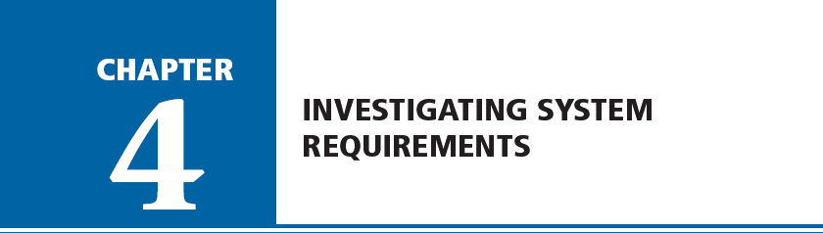

Systems Analysis and Design in a Changing World, Fifth Edition

Slide 2
The Analysis Phase in More Detail
Gather information
Define system requirements
  Functional and nonfunctional
Prioritize requirements
Prototype for feasibility and discovery
Generate and evaluate alternatives
Review recommendations with management
Systems Analysis and Design in a Changing World, 5th Edition

Slide 3
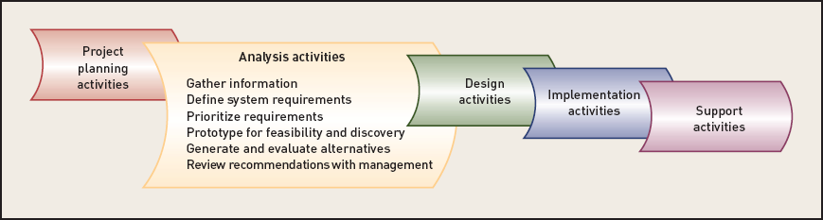
The Activities of the Analysis Phase ‏
Figure 4-3
Systems Analysis and Design in a Changing World, 5th Edition

Slide 4
System Requirements
System requirements – specifications that define the new system
Functional requirements
  Activities system must perform (use cases)‏
  Based on procedures and business functions
  Documented in analysis models
Systems Analysis and Design in a Changing World, 5th Edition

Slide 5
System Requirements (cont)‏
Nonfunctional requirements
  Technical requirement – hardware and software
  Performance requirement – workload measures
  Usability requirement – user interface, workflow
  Reliability requirement – outages, error detection
  Security requirement – access & protection
Systems Analysis and Design in a Changing World, 5th Edition

Slide 6
Models and Modeling
Analyst describes information system requirements using a collection of models
Complex systems require more than one type of model
Models represent some aspect of the system being built
Process of creating models helps analyst clarify and refine design
Models assist communication with system users
Systems Analysis and Design in a Changing World, 5th Edition

Slide 7
Types of Models
Different types of models are used in information systems development
  Mathematical – formulas that describe technical aspects of the system
  Descriptive – narrative memos, reports, or lists that describe aspects of the system
  Graphical – diagrams and schematic representations of some aspect of the system
Systems Analysis and Design in a Changing World, 5th Edition

Slide 8
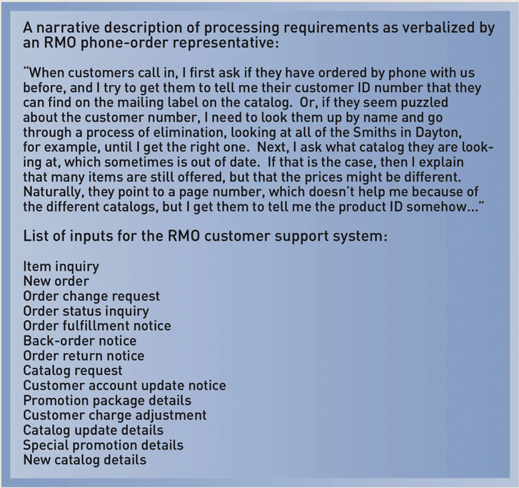
Some Descriptive Models
Figure 4-4
Systems Analysis and Design in a Changing World, 5th Edition

Slide 9
Stakeholders—The Source of
System Requirements
People with interest in successful system implementation
Three primary groups of stakeholders
  Users (use system)‏
  Clients (pay for and own system)‏
  Technical staff (ensure system operation)‏
Every type of stakeholder is identified by analyst
Systems Analysis and Design in a Changing World, 5th Edition

Slide 10
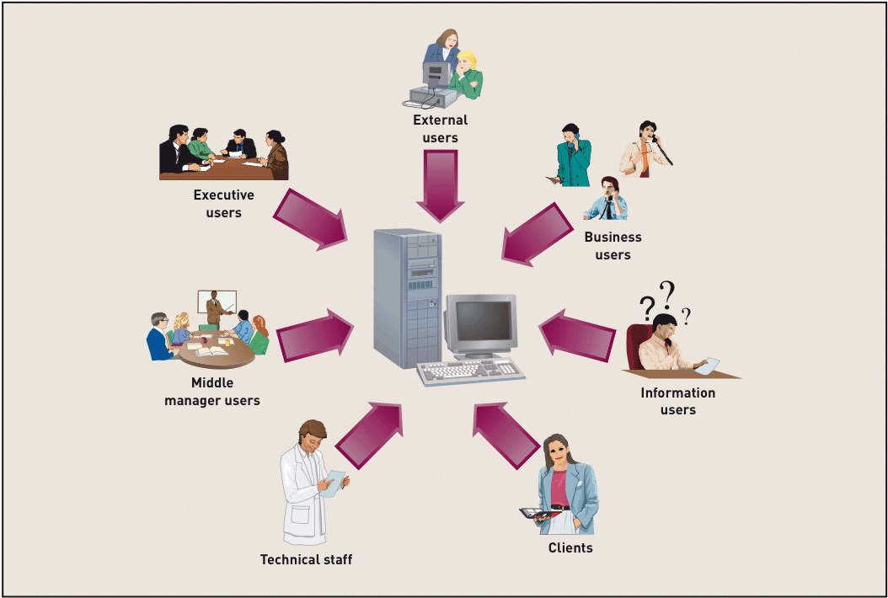
Stakeholders Interested in New System Development
Figure 4-6
Systems Analysis and Design in a Changing World, 5th Edition

Slide 11
More On Users as Stakeholders
Horizontal user roles – information flow across departments
Vertical user roles – information needs of clerical staff, middle management, and senior executives
  Business users perform day-to-day operations
  Information users need current information
  Management users need summary information
  Executive users need strategic information
  External users may have access to system
Systems Analysis and Design in a Changing World, 5th Edition

Slide 12
Techniques for Information Gathering
Analysis phase done to understand business functions and develop system requirements
Original structured approach
  Create model of existing system
  Derive requirements from existing system model
Current approach
  Identify logical requirements for new system
  Balance the review of current business functions with new system requirements
Systems Analysis and Design in a Changing World, 5th Edition

Slide 13
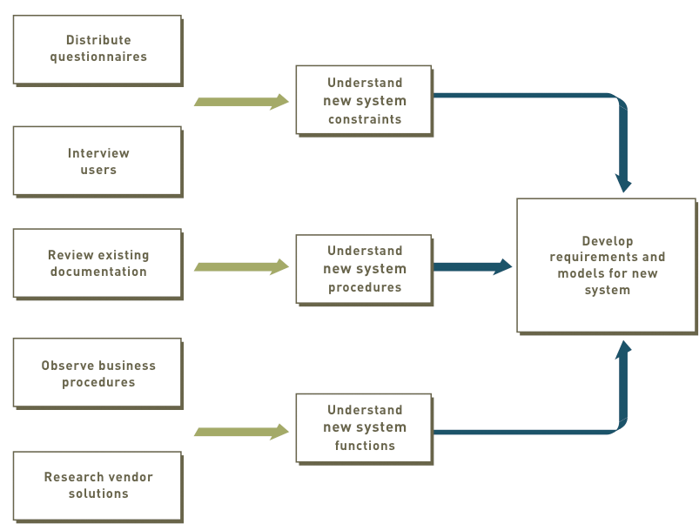
Relationship Between Information Gathering and Model Building‏
Figure 4-8
Systems Analysis and Design in a Changing World, 5th Edition

Slide 14
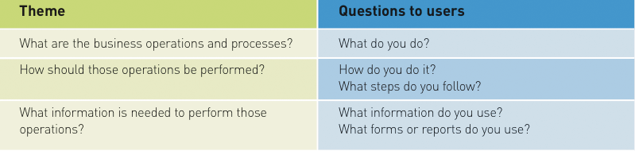
Themes for Information-Gathering Questions
Figure 4-9
Systems Analysis and Design in a Changing World, 5th Edition

Slide 15
Fact-Finding Methods
Review existing reports, forms, and procedure descriptions
Interview and discuss processes with users
Observe and document business processes
Build prototypes
Distribute and collect questionnaires
Conduct joint application design (JAD) sessions
Research vendor solutions
Systems Analysis and Design in a Changing World, 5th Edition

Slide 16
Review Existing Reports, Forms, and Procedure Descriptions
Source: External industry-wide professional organizations and trade publications
Source: Existing business documents and procedure descriptions within organization
  Identify business rules, discrepancies, and redundancies
  Be cautious of outdated material
  Obtain preliminary understanding of processes
  Use as guidelines/visual cues to guide interviews
Systems Analysis and Design in a Changing World, 5th Edition

Slide 17
Conduct Interviews and Discussions with Users
Effective way to understand business functions and rules
Time consuming and resource expensive
May require multiple sessions to
  Meet all users
  Understand all processing requirements
Can meet with individuals or groups of users
List of detailed questions prepared
Systems Analysis and Design in a Changing World, 5th Edition

Slide 18
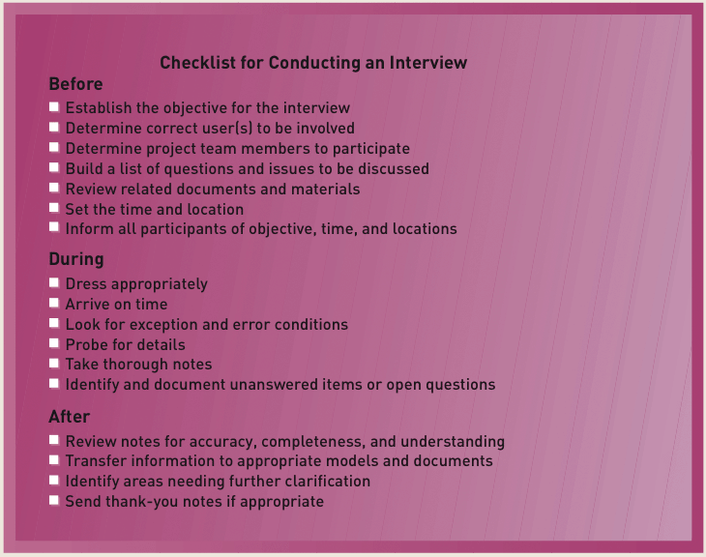
Sample Checklist to Prepare for User Interviews
Figure 4-11
Systems Analysis and Design in a Changing World, 5th Edition

Slide 19
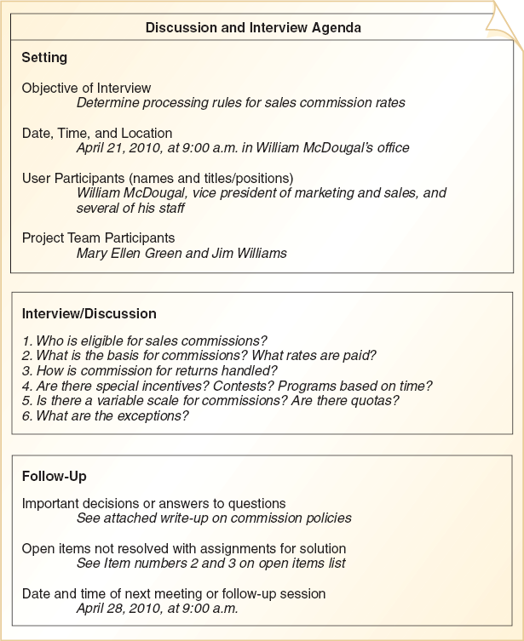
Sample Agenda for Interview
Figure 4-12
Systems Analysis and Design in a Changing World, 5th Edition

Slide 20
Observe and Document Business Processes
Varies from office walkthroughs to performing actual tasks
Not necessary to observe all processes at same level of detail
May make users nervous, so use common sense
Can document workflows with UML activity diagrams
Systems Analysis and Design in a Changing World, 5th Edition

Slide 21
Build Prototypes
Prototype - Preliminary working model of a larger, more complex system component
  Discovery, design, evolving prototypes
Prototype should be
  Operative
    Working model to provide “look and feel”
  Focused to accomplish single objective
  Quick
    Built and modified rapidly with CASE tools
Systems Analysis and Design in a Changing World, 5th Edition

Slide 22
Distribute and Collect Questionnaires
Limited and specific information from a large number of stakeholders
Preliminary insight into business
Not well suited for gathering detailed information
Closed-ended questions direct person answering question
Open-ended questions encourage discussion and elaboration
Systems Analysis and Design in a Changing World, 5th Edition

Slide 23
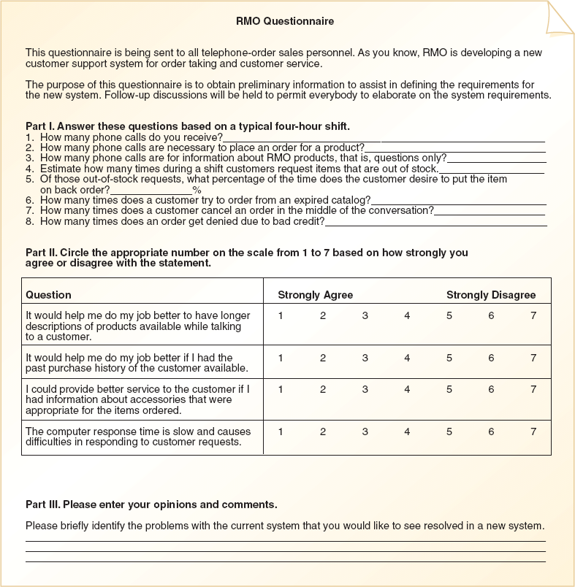
Sample RMO Questionnaire
Figure 4-17
Systems Analysis and Design in a Changing World, 5th Edition

Slide 24
Conduct Joint Application Design Sessions
Expedites investigation of system requirements
Seeks to compress fact-finding, modeling, policy formation, and verification activities into shorter time frame
Critical factor is to have all important stakeholders present
Systems Analysis and Design in a Changing World, 5th Edition

Slide 25
Joint Application Design Participants
Session leader trained in group dynamics and JAD group facilitation
Knowledgeable business and system users and policy makers
Technical staff representatives to handle
  Computer and network configurations
  Operating environments
  Security issues
Project team members
Systems Analysis and Design in a Changing World, 5th Edition

Slide 26
Joint Application Design Facilities
Conducted in special room
  Limit interruptions
  May be off-site
Resources
  Overhead projector, white board, flip charts, work material
  Electronic support (laptops)‏
  CASE tools
  Group support systems (GSS)‏
Systems Analysis and Design in a Changing World, 5th Edition

Slide 27
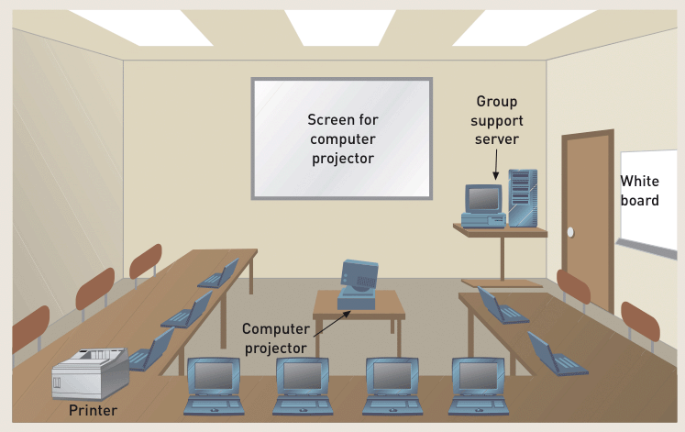
A JAD Facility
Figure 4-18
Systems Analysis and Design in a Changing World, 5th Edition

Slide 28
Research Vendor Solutions
Many problems have been solved by other companies
Positive contributions of vendor solutions
  Frequently provide new ideas
  May be state of the art
  Cheaper and less risky
Danger
  May purchase solution before understanding problem
Systems Analysis and Design in a Changing World, 5th Edition

Slide 29
Useful Techniques in Vendor Research
Technical specifications from vendor
Demo or trial system
References of existing clients
On-site visits
Printout of screens and reports
Systems Analysis and Design in a Changing World, 5th Edition

Slide 30
Validating the Requirements
Make sure gathered information is correct
Structured walkthrough
  Effective means of implementing quality control early in project
  Verify and validate system requirements
  Review of findings from investigation and of models based on findings
Project manager responsible for system quality
  Systems analyst, project manager are partners
Systems Analysis and Design in a Changing World, 5th Edition

Slide 31
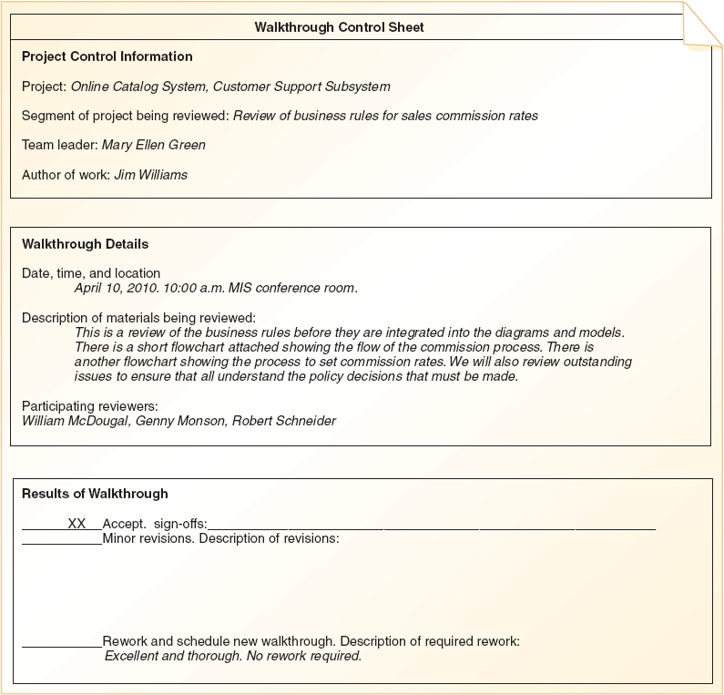
Structured Walkthrough Form
Figure 4-19
Systems Analysis and Design in a Changing World, 5th Edition

